Slide 1

JavaScript Chapter 13: Concurrency

Slide 2
Introduction
It's time for a more advanced topic. You're ready! We are going to deal with the topic of asynchronous code and some options for multitasking with code. This concept is called concurrency. Don't worry if you find this chapter a bit of a struggle; this is programming in JavaScript at a high level. These are the topics we'll be dealing with:
Concurrency
Callbacks
Promises
async/await
Event loop
Yes, this is tough, but understanding how to leverage concurrency can really enhance the performance of your program by speeding up the process, which is more than enough reason to dive into this advanced topic!

Slide 3
Introducing concurrency
Concurrency is whenever things are happening "at the same time" or in parallel. To give a non-code example, let's talk about managing my household. When I come home on a Friday night, I have a series of tasks: the kids need to eat, to shower, and to be brought to bed, the laundry needs to be folded and laundry needs to be put in the machine, and to be fair, a lot more, but this is enough to illustrate the example.
If I were to do this without being able to do multiple things at once, it would be a very tough night and get very late. I would first make dinner—put a pizza in the oven and wait next to it—feed the kids, shower them afterward, then bring them to bed, and then fold the laundry afterward, turn the machine on again, and wait until it's done. Luckily, I can multitask, so it looks more like this: I put the pizza in the oven, in the meantime, I turn the washing machine on and maybe fold a few pieces of laundry, then I feed the kids, do the rest of the laundry while they shower, and I'm done a lot quicker.
This is the same for your computer and the applications that you use. If it weren’t able to do multiple things at the same time, you would probably be very annoyed. You wouldn't be able to check your mail while you are writing code, you wouldn’t be able to listen to music while writing code, and a lot more. This is your computer switching between different tasks. The same thing can happen at the application level. For example, we can do a call to some API and not wait for the reply but do something useful in the meantime instead. We can do so using the concept of concurrency.
There are three strategies in JavaScript that you'll need to know of when working with concurrency: callbacks, Promises, and the async and await keywords.

Slide 4
Callbacks
Callbacks are the first thing we should understand when we are talking about concurrency. The good news is that the callback principle is not too hard to understand. It is just a function that takes another function as an argument, which is then called when the rest of the initial function has finished. In other words, it's just a function calling a function, like this:
The doSomething() function, which is created with the parameter callback, is just calling whatever function is being passed in as an argument. We call it using the sayHi() function as an argument, so this code snippet is just a very complicated way to get Hi! printed to the console.
function doSomething(callback) {
callback();
}
function sayHi() {
console.log("Hi!");
}
doSomething(sayHi);

Slide 5
Callbacks
Here is an example of the callback principle actually doing something:
function judge(grade) {
switch (true) {
case grade == "A":
console.log("You got an", grade, ": amazing!");
break;
case grade == "B":
console.log("You got a", grade, ": well done!");
break;
case grade == "C":
console.log("You got a", grade, ": alright.");
break;
case grade == "D":
console.log("You got a", grade, ": hmmm...");
break;
default:
console.log("An", grade, "! What?!");
}
}
Continues →

Slide 6
Callbacks
function getGrade(score, callback) {
let grade;
switch (true) {
case score >= 90:
grade = "A";
break;
case score >= 80:
console.log(score);
grade = "B";
break;
case score >= 70:
grade = "C";
break;
case score >= 60:
grade = "D";
break;
default:
grade = "F";
}
callback(grade);
}
getGrade(85, judge);

Slide 7
Callbacks
There are two functions here: judge() and getGrade(). We call the function getGrade() with two arguments: 85 and the function judge(). Note that when calling the function as an argument, we do not include the parantheses. The judge() function gets stored in a callback. After determining the grade, the function that is stored in a callback (judge() in this case) gets called with the grade.
This could also be another function that does something more useful than judging, for example, sending a certain email based on test results. If we wanted that, we actually wouldn't need to change the getGrade() function; we just need to write a new function to do this and call getGrade() with the new function as a second argument.
You might be very disappointed right now, because this is not too exciting. Callbacks become really valuable in an asynchronous context, for example, when one function is still waiting for the results of a call to the database before calling the callback function that is going to process the data.

Slide 8
Callbacks
Some JavaScript built-in functions work with this callback principle, for example, the setTimeOut() and setInterval() functions. They will take a function that is executed after a certain time in the case of a timeout and every certain amount of time for the specified interval. We have seen these already, but just as a reminder:
setInterval(encourage, 500);
function encourage() {
console.log("You're doing great, keep going!");
}
The functions that are inserted as arguments are called callbacks here. Understanding concurrency really starts with callbacks, but multiple nested callbacks make code difficult to read.
When this is all written as one function with anonymous functions inside, this gets very indented as well. We call this callback hell or the Christmas tree problem (because the code gets nested so much, it looks like a Christmas tree on its side).
Callbacks are a great concept, but they can create ugly code very fast. There is often a better solution, we promise.

Slide 9
Practice exercise 13.1
This exercise will demonstrate how to use a callback function, creating a way to pass a value from one function to another by invoking a callback function. We will create a greeting callback using a full name in a string.
Create a function named greet() that takes one argument, fullName. That argument should be an array. Output the items of the array into the console interpolated into a greeting message string.
Create a second function that has two arguments: the first one is a string for the user's full name, and the second is the callback function.
Split the string into an array using the split() method.
Send the full-name array to the greet() function created in the first step.
Invoke the process of the callback function.

Slide 10
Practice exercise 13.1
With Promises, we can organize the sequence of our code in a slightly easier-tomaintain way. A Promise is a special object that connects code that needs to produce a result and the code that needs to use this result in the next step.
When we create a Promise, we give it a function. In the following example, we use a convention that we have seen a lot; we are creating a function on the spot. So, inside the argument list we are defining the function, often done using arrow functions as well. This function needs two parameters, and these parameters are callbacks. We have called them resolve and reject here.
When resolve() is called, the Promise is presumed to be successful and whatever is between the arrows is returned and used as input for the then method on the Promise object. If reject() is called, the Promise failed and the catch() method on the Promise object (if present) is executed with the argument of the reject() function.

Slide 11
Practice exercise 13.1
This is a lot of information that can be hard to understand at first, so here is an example of a Promise to help you:
let promise = new Promise(function (resolve, reject) {
// do something that might take a while
// let's just set x instead for this example
let x = 20;
if (x > 10) {
resolve(x); // on success
} else {
reject("Too low"); // on error
}
});
promise.then(
function (value) {
console.log("Success:", value);
},
function (error) {
console.log("Error:", error);
}
);

Slide 12
Practice exercise 13.1
We first create a Promise. When creating a Promise, we don't know what the value of the Promise is going to be. This value is whatever is sent as an argument to the resolve function. It is a sort of placeholder.
So when we call then on the Promise, we basically say: figure out what the value of the Promise is, and when you know, execute one function if the Promise was resolved or a different function if it was rejected. When a Promise is neither resolved nor rejected, we say that the Promise is pending.

Slide 13
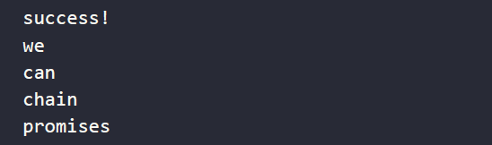
Practice exercise 13.1
then() is a Promise itself, so when it returns we can use the result for the next then() instance. This means we can chain the then() instances, which can look like this:
This will log:
const promise = new Promise((resolve, reject) => {
resolve("success!");
}).then(value => {
console.log(value);
return "we";
}).then(value => {
console.log(value);
return "can";
}).then(value => {
console.log(value);
return "chain";
}).then(value => {
console.log(value);
return "promises";
}).then(value => {
console.log(value);
}).catch(value => {
console.log(value);
})

Slide 14
Practice exercise 13.1
The resolve functions are implemented with an arrow function. The return statement is the value input for the next function. You can see that the last block is a catch() function. If any of the functions were to result in a rejection and the Promise were therefore rejected, this catch() block would be executed and print whatever the reject() function sent to the catch() method. For example:
This will just log oops… because the first Promise was rejected instead of resolved. This is great for creating asynchronous processes that need to wait till another process is complete. We can try to do a certain set of actions and when something goes wrong, use a catch() method to deal with it.
const promise = new Promise((resolve, reject) => {
reject("oops... ");
}).then(value => {
console.log(value);
return "we";
}).then(value => {
console.log(value);
return "can";
}).then(value => {
console.log(value);
return "chain";
}).then(value => {
console.log(value);
return "promises";
}).then(value => {
console.log(value);
}).catch(value => {
console.log(value);
})

Slide 15
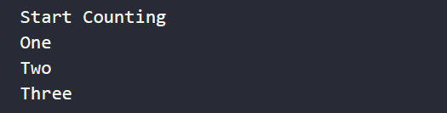
Practice exercise 13.2
In this exercise, you will create a counter that will output the values in sequence using Promises.
Set up a Promise that resolves with a value of Start Counting.
Create a function named counter() that has one argument that gets the value and outputs it into the console.
Set up the next function in the Promise with four then() instances, which should output a value into the counter function, and return a value which will provide input for the subsequent then() instance. The returned values should be one, then two, then three. The screen output in the console should be the following:

Slide 16
async and await
We have just seen the Promise syntax. With the async keyword, we can make a function return a Promise. This makes the Promises nicer to read and look a lot like synchronous (non-concurrent) code. We can use this Promise just like we learned in the previous section, or we can use the more powerful await keyword to wait until the Promise is done. await only works in an asynchronous function.
In an asynchronous context, we can await other Promises as well, as can be seen in this example:
function saySomething(x) {
return new Promise(resolve => {
setTimeout(() => {
resolve("something" + x);
}, 2000);
});
}
async function talk(x) {
const words = await saySomething(x);
console.log(words);
}
talk(2);
talk(4);
talk(8);

Slide 17
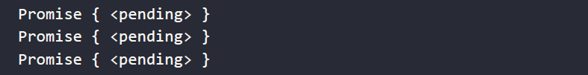
async and await
Can you figure out what this code does? We call the asynchronous function talk() three times in a row with no break. Each of these function calls is awaiting the saySomething() function. The saySomething() function contains a new Promise that is being resolved with a setTimeout() function that waits two seconds before resolving with the value of something plus x. So after two seconds, the three functions are done at the same time (or so it seems to the human eye).
If the talk() function were not asynchronous, it would throw a SyntaxError because of the await keyword. await is only valid in asynchronous functions, so talk() must be asynchronous. Without the async and the await in this example, it would store the result of the function saySomething(), a pending Promise, in words and log that once for every function call:
We have now seen the basic building blocks of concurrency. This should prepare you for working with concurrency in real life. Concurrency really is an advanced topic; debugging it is troublesome, but it is really worth while in terms of performance when applied at the right moment.

Slide 18
Practice exercise 13.3
This exercise will demonstrate how to use await to wait on a Promise inside an async function. Using await and async, create a counter with timeout(), and increment a global counter value.
Create a global value for a counter.
Create a function that takes one argument. Return the result of a new Promise, setting a setTimeout() function that will contain the resolve instance.
Increment the counter within setTimeout(), adding one every second. Resolve the Promise with the value of the counter and the value of the variable that was in the function argument.
Create an asynchronous function that outputs into the console the value of the global counter and the value of the argument of the function.

Slide 19
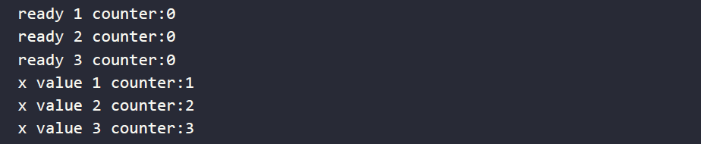
Practice exercise 13.3
Create a variable to capture the returned resolve value from the await function. Output that result into the console.
Create a loop to iterate 10 times, incrementing the value and invoking the async function, passing the value of the increment variable as the parameter in the function.
The results should look like the following:

Slide 20
Event loop
We would like to end this chapter by explaining how JavaScript handles asynchrony and concurrency under the hood. JavaScript is a single-threaded language. A thread in this context means a path of execution. If there is only a single path, this means that tasks will have to wait for one another and only one thing can happen at a time.
This single executor is the event loop. It's a process that executes the actual work. You may wonder about this, because you've just learned about concurrency and doing things asynchronously and at the same time. Well, even though JavaScript is single-threaded, it doesn't mean that it cannot outsource some tasks and wait for them to come back. This is exactly how JavaScript manages to do things in a multithreaded manner.

Slide 21
Call stack and callback queue
JavaScript works with a call stack, and all the actions that it has to execute are queued up here. The event loop is a process that is constantly monitoring this call stack, and whenever there are tasks to do, the event loop does them one by one. The tasks on top get executed first.
Here's a tiny script:
console.log("Hi there");
add(4,5);
function add(x, y) {
return x + y;
}

Slide 22
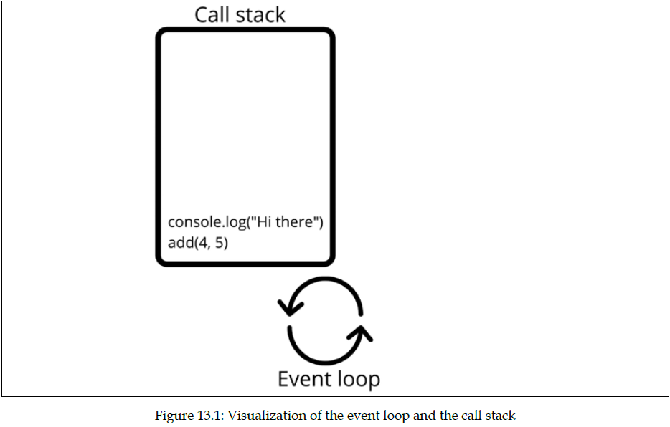
Call stack and callback queue
Here's a visualization of the call stack and event loop for this script.

Slide 23
Call stack and callback queue
No multithreading is going on here. But it is here:
The setTimeout() task gets outsourced to the browser's web API (more on APIs in Chapter 15, Next Steps). When it's done, this appears in a special place: the callback queue. When the call stack is empty (and only then!), the event loop will check the callback queue for work to do. If there are any callbacks waiting, they'll be executed, one by one. After every action, the event loop will check the call stack for work first.
console.log("Hi there");
setTimeout(() => console.log("Sorry I'm late"), 1000);
console.log(add(4, 5));
function add(x, y) {
return x + y;
}

Slide 24
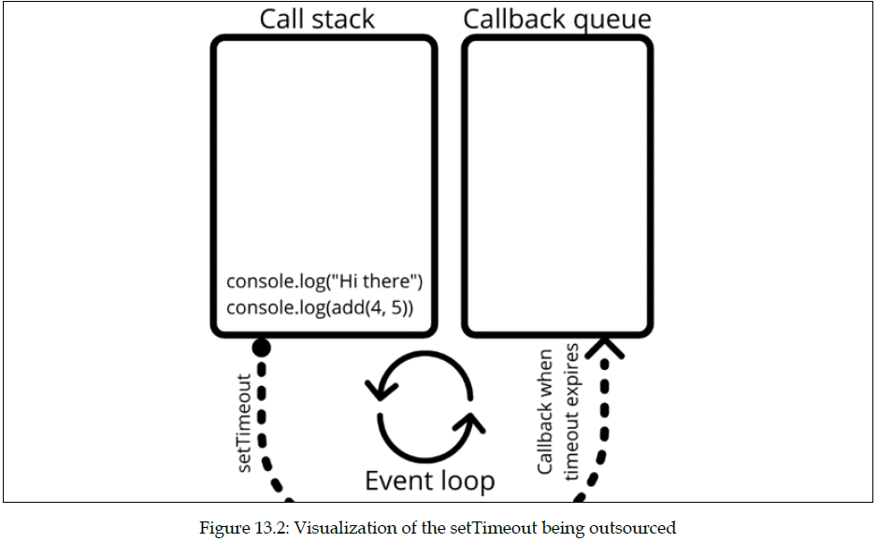
Call stack and callback queue
Here's a visualization of the situation with the outsourcing of setTimeout():

Slide 25
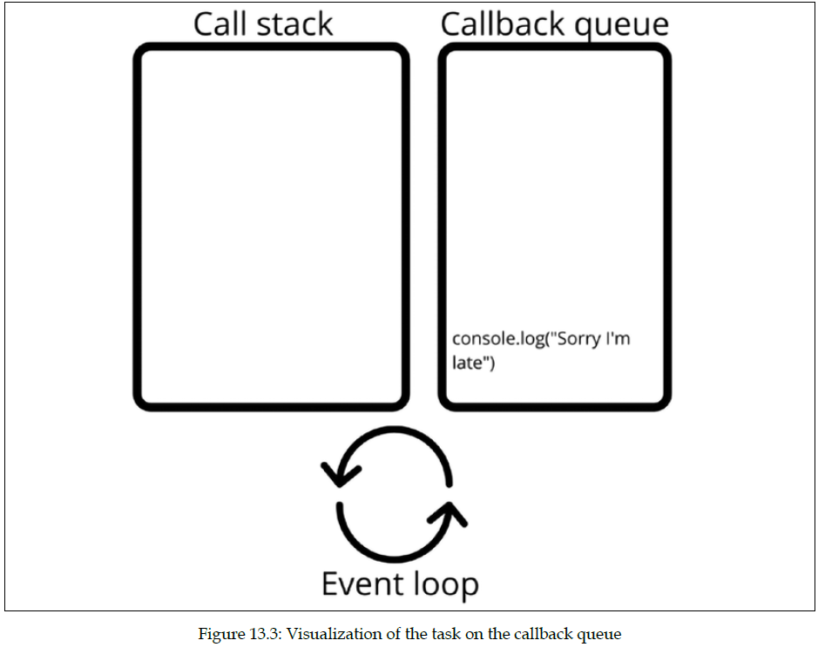
Call stack and callback queue
When setTimeout() expires, the event loop will have done whatever was on the call stack already, and will check the callback queue and execute any tasks on there:

Slide 26
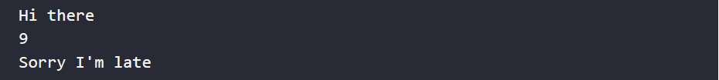
Call stack and callback queue
And this is what it will output:
Let's see if you read the above text well. What do you think will happen when we set the timer to 0, like here?
This will output the exact same thing. setTimeout() will also be outsourced when the timer is at 0. The callback is placed in the callback queue right away, but the event loop won't even check the callback queue until the callstack is empty. So it will still print Sorry I'm late after 9, even though the timer is at 0.
console.log("Hi there");
setTimeout(() => console.log("Sorry I'm late"), 0);
console.log(add(4,5));
function add(x, y) {
return x + y;
}

Slide 27
Password checker
Using an array of allowed passwords, this exercise will create an application to check if one of these password string values exists in an array that lists all the accepted passwords. Set a Promise to check if the password is valid, and upon the result either resolve with the status of true or reject with the status of false. Return the check results.
Create an array of allowed passwords.
Create a login function that will check if the argument is a value that is included in the passwords array. You can use indexof() or the includes() method to check the array for a value and return a Boolean value of the result.
Add a function that returns a Promise. Using resolve and reject, return a JavaScript object with the Boolean of true or false to indicate the password validity status.
Create a function that checks the password, sending it to the login function, and using then() and catch(), outputs the result of either the rejected password or the resolved password.
Send several passwords, some within the array, others not, to the checker function.

Slide 28
Self-check quiz
Fix the error in the following code to use the callback function:
function addOne(val){
return val + 1;
}
function total(a, b, callback){
const sum = a + b;
return callback(sum);
}
console.log(total(4, 5, addOne()));

Slide 29
Self-check quiz
Write down the result of the following code:
function checker(val) {
return new Promise((resolve, reject) => {
if (val > 5) {
resolve("Ready");
} else {
reject(new Error("Oh no"));
}
});
}
checker(5)
.then((data) => {console.log(data); })
.catch((err) => {console.error(err); });

Slide 30
Self-check quiz
What line(s) of code need to be added to the preceding function so that there is always a result after the function runs that ensures the word done is output into the console?
Update the below code to make the function return a Promise:
function myFun() {
return "Hello";
}
myFun().then(
function(val) { console.log(val); },
function(err) { conole.log(err); }
);

Slide 31
Summary
In this chapter, we've discussed concurrency. Concurrency enables our code to do multiple things at the same time and we can determine the order of things using callbacks, Promises, and the async and await keywords. Implementing these in your applications and pages will improve the user experience a lot! Users are quite demanding nowadays; if a website isn't loading fast enough, they bounce (go back to, for example, Google). Concurrency helps to deliver results faster.
The next two chapters are about using JavaScript for modern web development and will be dealing with HTML5 and JavaScript and modern JavaScript frameworks that are real game-changers.

